Slide 1


Slide 2

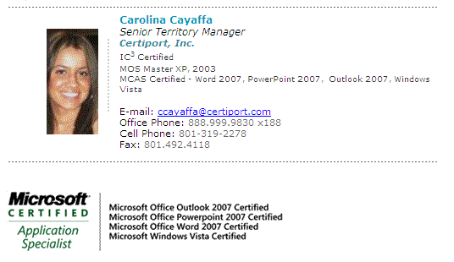
Arkansas Sales Contact
Notes:
Introduce Carolina Cayaffa as Arkansas’ new account rep!!

Slide 3

MCAS and Adobe
Certifications
Debora A. Collins
Certiport, Inc.
Notes:
Title Slide

Slide 4







Debora A. Collins
Certiport, Inc.
dcollins@certiport.com
      M.S. Curriculum & Instruction, Brigham Young University-1985
      Microsoft Certified Learning Consultant (MCLC)
      Microsoft Certified Trainer (MCT)
      Microsoft Certified Application Specialist (MCAS)
      Microsoft Office Specialist (MOS)
      Adobe Certified Associate (ACA)
      Internet and Computing Core Certification (IC³)
      MCT Flash Columnist – “Microsoft Office Tip of the Month”
Notes:
Sample Script:
Debbie will briefly emphasize her experience and credentials relating to this presentation.

Slide 5
Session Agenda
Microsoft® Business Certifications
  Microsoft Office Specialist (MOS)
  Microsoft Certified Application Specialist (MCAS)
    Adobe Certified Associate (ACA)
    Internet and Computing Core Certification (IC³)
    Q & A
    Submit Evaluation
Notes:
Sample Script:
Introduce the session agenda.

Slide 6
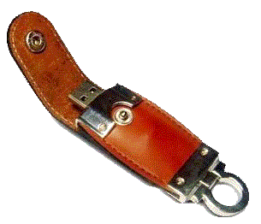

At the end of the session submit an evaluation and receive a FREE gift!
Notes:
Sample Script:
Bribe the audience that if they stay for the entire session and submit an evaluation upon exiting they will receive a USB drive as our thank you gift for attending!

Slide 7

Microsoft® Business Certifications
Notes:
Sample Script:
Introduce that this first section will show evidence that employers are beginning to reward Office certifications.

Slide 8
Microsoft Office Statistics
“There are 450 million Microsoft Office users worldwide!”
Peter Pathe, Microsoft Corporate Vice President , Jan. 4, 2007
“…people actually use less than 20 percent of the software functions they have at their disposal.”
        Barbara Darrow, CRN, July 7, 2005
Notes:
8
8
Sample Script:
Discuss the statistics presented on the slide.

Slide 9
Microsoft Office Statistics
“There are 450 million Microsoft Office users worldwide!”
Peter Pathe, Microsoft Corporate Vice President , Jan. 4, 2007
“…people actually use less than 20 percent of the software functions they have at their disposal.”
        Barbara Darrow, CRN, July 7, 2005
Challenge = Close the gap!
Nothing increases skill level like certification – Greater opportunities exist for those
who certify.
Notes:
9
9
Sample Script:
Emphasize that certification addresses the problem.

Slide 10

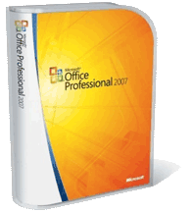
“Tools” of the Information Worker
Most common applications are:
Word
Outlook
Excel
PowerPoint
Access
Notes:
Sample Script:
Discuss that MS Office is #1 desktop productivity suite of software used in the world today..

Slide 11
The MCAS and MOS Programs
  Microsoft Certified Application Specialist (MCAS)
  Word, Excel, PowerPoint, Outlook, Access or Vista
  Microsoft Office 2007
  Microsoft Office Specialist (MOS)
  Word, Excel, PowerPoint, Outlook, Access
  Microsoft Office 2003
  “Ideal” Candidates for Certification
    College/University Students
    Information Workers
    Business Application Trainers
Notes:
Sample Script:
Explain the two Microsoft Business Certification programs. Explain that this presentation will focus on MCAS.

Slide 12
MCAS Word Objectives
Create & Customize Documents
Create, format & layout documents
Make content easier to find
Personalize Office Word 2007
Format Content
Format text & paragraphs
Manipulate text
Control Pagination
Organize Content
Structure content with Quick Parts
Use & modify tables & lists
Insert references & captions
Merge documents & data sources
Work with Virtual Content
Insert & format illustrations
Format text graphically
Insert & modify text boxes
Review Documents
Navigate documents
Compare & merge document versions
Manage tracked changes
Insert, modify & delete comments
Share and Secure Content
Prepare documents for sharing
Control document access
Attach digital signatures
Notes:
Sample Script:
Introduce the six topics covered on the exam and briefly list each of the objectives. Also, mention that the objectives for all of the MCAS exams (Word, Excel, PowerPoint, Outlook, Access and Vista) are posted on Microsoft’s website.

Slide 13
MCAS Excel Objectives
Create & Modify Formulas
Reference data in formulas
Summarize data using subtotals
Conditionally summarize data
Lookup data using a formula
Use conditional logic formulas
Format text using formulas
Display and print formulas
Collaborating & Securing Data
Protect and share workbooks
Prepare & save workbooks
Set printing options
Use AutoFilter
Filter & sort using conditional formats
Create and Manipulate Data
Insert data using AutoFill
Ensure data integrity
Modify cell contents & formats
View & Manage Worksheets
Format Data & Content
Format Worksheets
Insert & modify rows& columns
Format cells and tables
Present Data Visually
Create, format & modify charts
Apply conditional formatting
Insert & modify illustrations
Outline, sort & filter data
Notes:
Sample Script:
Introduce the five topics covered on the exam and briefly list each of the objectives. Also, mention that the objectives for all of the MCAS exams (Word, Excel, PowerPoint, Outlook, Access and Vista) are posted on Microsoft’s website.

Slide 14

MCAS Outlook Objectives
Managing Messaging
Create and send an e-mail message
Create signatures and auto messages
Manage E-mail attachments
Configure sensitivity and importance
Configure security and delivery settings
View E-mail messages
Managing Scheduling
Create appts., meetings and events
Send meeting requests
Update, cancel and respond to requests
Customize calendar settings
Share and view calendars
Managing Tasks
Create, modify, and mark tasks
Accept, decline, assign, update and
respond to tasks
Managing Contacts
Create and modify contacts
Edit and use an electronic business card
Create and manage distribution lists
Create a secondary address book
Organizing Information
Categorize Outlook 2007 items by color
Create and manage Outlook data files
Search for Outlook 2007 items
Create and manage rules
Notes:
Sample Script:
Introduce the five topics covered on the exam and briefly list each of the objectives. Also, mention that the objectives for all of the MCAS exams (Word, Excel, PowerPoint, Outlook, Access and Vista) are posted on Microsoft’s website.

Slide 15
MCAS PowerPoint Objectives
Creating & Formatting Presentations
Create new presentations
Customize slide masters
Add elements to slide masters
Create and change elements
Arrange slides
Creating & Formatting Slide Content
Insert and format text boxes
Manipulate text
Add and link content
Apply, customize, modify and
remove animations
Work with Visual Content
Create SmartArt diagrams
Modify SmartArt diagrams
Insert illustrations and shapes
Modify illustrations
Arrange illustrations and other content
Insert and modify charts
Insert and modify tables
Collaborating and Delivering
Review presentations
Protect presentations
Secure and Share presentations
Prepare printed materials
Prepare for and rehearse delivery
Notes:
Sample Script:
Introduce the four topics covered on the exam and briefly list each of the objectives. Also, mention that the objectives for all of the MCAS exams (Word, Excel, PowerPoint, Outlook, Access and Vista) are posted on Microsoft’s website.

Slide 16
MCAS Access Objectives
Creating and Modifying Queries
Create queries
Modify queries
Presenting and Sharing Data
Sort data
Filter data
Create and modify charts
Export data
Save database objects as other file types
Print database objects
Managing and Maintaining Databases
Perform routine database operations
Manage databases
Structuring a Database
Define data , types & relationships
Print table relationships
Add, change, remove primary keys
Split databases
Creating and Formatting Elements
Create databases
Create and modify forms and reports
Create and modify tables
Create and modify field properties
Entering and Modifying Data
Enter, edit and delete records
Navigate records; Find/Replace data
Attach documents to records
Import data
Notes:
Sample Script:
Introduce the six topics covered on the exam and briefly list each of the objectives. Also, mention that the objectives for all of the MCAS exams (Word, Excel, PowerPoint, Outlook, Access and Vista) are posted on Microsoft’s website.

Slide 17
MCAS Vista Objectives
Managing Software, Disks & Devices
Manage software, disks, devices & drivers.
Manage display and multiple monitors
Install and configure a printer
Managing Files and Folders
Manage Windows Explorer settings
Secure and share folders
Search for files and folders
Organize and manage files within folders
Back up and restore files and folders
Customizing Windows Vista
Customize the Start menu and taskbar
Personalize the appearance & sound
Manage the Windows Sidebar
Collaborating with Other People
Collaborate in real time
Present information to an audience
Protecting Your Computer
Manage Windows Firewall, Malware & IE
Configure Windows Update settings
Lock a computer
Configure local user accounts
Managing Mobile & Remote Computing
Manage power states & network connections
Manage remote access to your computer
Connect to another computer
Configure and access offline files & folders
Optimizing & Troubleshooting a Computer
Increase processing speed
Locate troubleshooting & system information
Repair a network connection
Recover from software & OS errors
Troubleshoot printing errors
Request and Manage Remote Assistance
Notes:
Sample Script:
Introduce the seven topics covered on the exam and briefly list each of the objectives. Also, mention that the objectives for all of the MCAS exams (Word, Excel, PowerPoint, Outlook, Access and Vista) are posted on Microsoft’s website.

Slide 18

MCAS Master Certification
Pass the following exams to become an MCAS Master!
  Word 2007
  Excel 2007
  PowerPoint 2007
  Outlook 2007
Notes:
Sample Script:
Mention that any candidate passing the four exams listed receives “Master” certification!

Slide 19
Become an MCT!
Have you ever thought about becoming a Microsoft Certified Trainer (MCT)?
Obtain one or more MOS or MCAS certifications and complete the application.
Notes:
Sample Script:
Mention that any candidate passing the four exams listed receives “Master” certification!

Slide 20
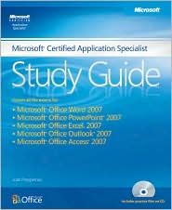
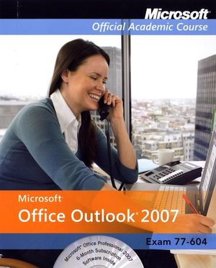
Microsoft Learning Resources
MOAC Series for Office 2007
MCAS Study Guide
Notes:
Sample Script:
Mention that there are many MCAS textbooks on the market today. Explain that these are Debbie’s favorites because:
1. They encourage MCAS certification;
2. They have the highest correlation to the actual exam skill objectives;
3. Students give good feedback regarding these books after they’ve sat the actual exam;
4. They are the “best buy” compared to other texts on the market.

Slide 21
MS Press MCAS Study Guide
All-in-one (Word, Excel, PowerPoint, Outlook, and Access)
Covers all the exam objective skills
Good self-study book with practice files
Offers 25% discount on MCAS exam voucher
Includes a FREE online skills pre-assessment
To purchase, go to http://www.amazon.com
Notes:
Sample Script:
Explain the bullet points on the slide.

Slide 22
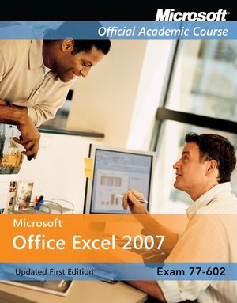

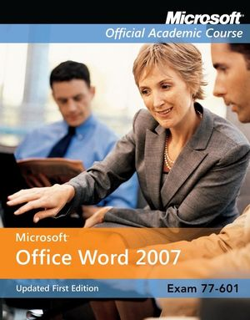
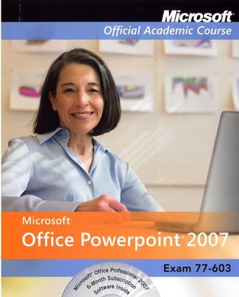

Wiley & Sons, Inc. MOAC Series
Includes a 6-month Office 2007 Trial Edition with text!
Instructor’s Guide, Test Bank, PowerPoint Slides
1-year membership to MSDN with MOAC adoption!
Optional bundles include Pre-test and MCAS Exam!
  Note: Must be an accredited school to purchase MOAC
    For more info, contact MOAC@wiley.com
Notes:
Sample Script:
Explain the bullet points on the slide.

Slide 23

Certiprep by Certiport
Available for MOS or MCAS
Same environment as the REAL exam!
Two modes: Learning and Practice Test
Available in Stand-alone and Network versions
Stand-alone version uses Terminal Services, so
an installation of MS Office 2007 is NOT required!
For more info, contact ccayaffa@certiport.com
Notes:
Sample Script:
Explain the bullet points on the slide.

Slide 24
Microsoft Office Site License
$ 40,000 value!
500 Microsoft Office exams (either MOS or MCAS)
Certiprep Licenses (2003 or 2007) – Network Version
Per school 1 yr. subscription only $2,950!!
Does NOT include Microsoft Office software!
For more info, contact ccayaffa@certiport.com
Notes:
Sample Script:
Explain the bullet points on the slide.

Slide 25
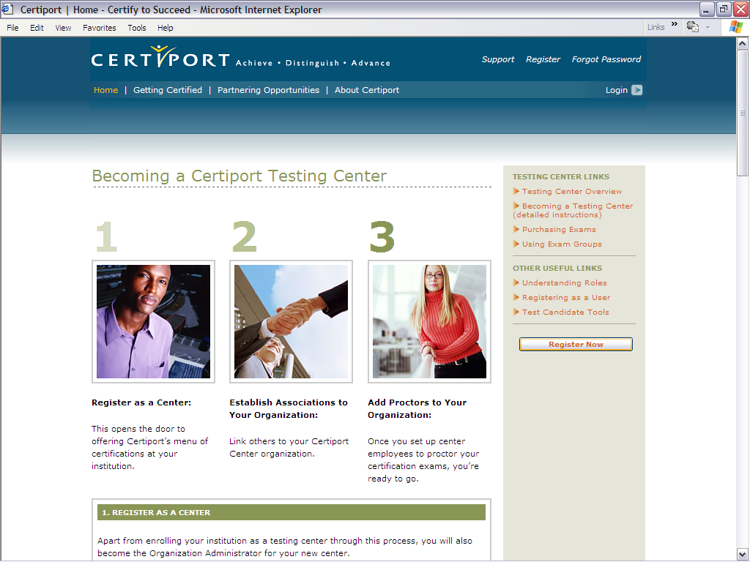
Register a Test Center
Visit Certiport’s homepage at
www.certiport.comand click the button, “Register a Testing Center”.
Complete the application form and purchase enough MCAS exams for your students.
Notes:
Sample Script:
Discuss how easy it is to obtain a Certiport Testing Center.

Slide 26
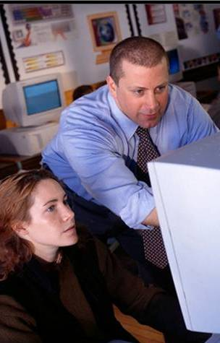
MCAS Exam Characteristics
This is what to expect -
Performance-based exam
50 minute length
20-30 test items with one or more tasks
Score required to pass varies with exam
(most IT exams range from 65-80%)
Source: US Dept. of Education, October 2000
Skills measured are posted on Microsoft’s
website (the objectives previously discussed)
Notes:
Sample Script:
Briefly discuss the general characteristics of an MCAS exam.
Point out that the score required to pass a Microsoft Office exam is typical of other exams in the IT industry.
A study released by the US Dept. of Education in a publication titled, A Parallel Postsecondary Universe: The Certification System in Information Technology - October 2000 reveal that “cut-scores” for certification exams in the IT industry typically range between 65-80%.
As stated in the Microsoft Office 2003 Step by Step books:
“Passing standards (the minimum required score) for Microsoft Office
Specialist certification exams range from 60 to 85 percent correct,
depending on the exam.”
4. Explain that “cut-scores” can change as IT exams are updated during their lifecycle.
5. Explain that the 85%+ score participants are required to achieve when preparing for a workshop is to help them master the skills needed to more easily achieve the “cut-score” required on the actual certification exams.

Slide 27
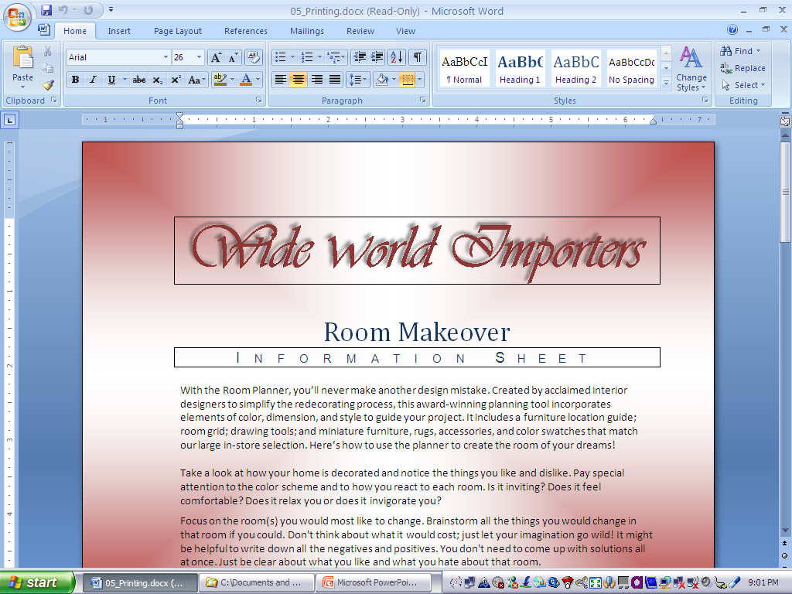
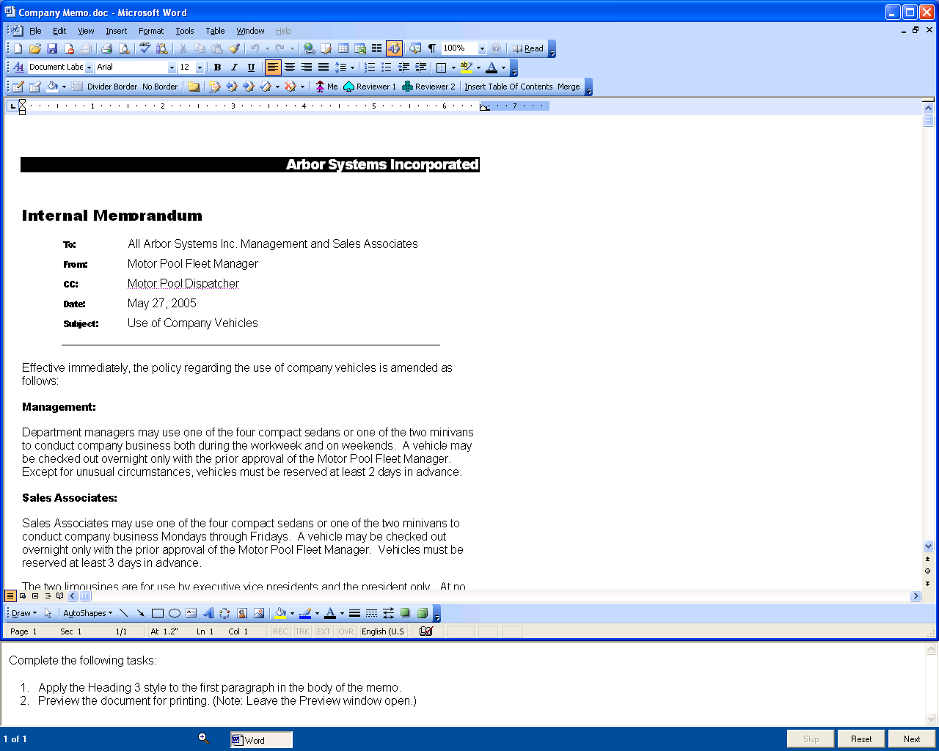
Sample Exam Question
“Live” Office application appears in upper portion of window. All features work except Help!
Task pane is at bottom. Has counter, timer and buttons for Skip, Reset and Next.
48:15
Notes:
Sample Script:
Explain the anatomy of an MCAS exam question or “test item” as follows:
There are four pages of instructions which will be presented at the beginning of the exam. These pages are not timed. Encourage participants to thoroughly read thru these four pages.
Explain that the 50-minute time does not begin until the first test item appears.
Explain the layout of a “test item” with the familiar Word application window on top and the exam window on the bottom.
Explain that each test item will have one or more tasks to complete. Tasks can be completed in any order unless specified. Partial credit will be granted for each completed task.
Explain how to track your progress with the display of the question number (x of y).
Explain the “Time Remaining” counter
Explain the Skip button
Explain the Reset button
Explain the Next button. Emphasize that the tasks are not scored until the Next button is pressed. Excessive mouse clicks and movements are not scored as penalties; however unnecessary committed actions are penalized (i.e., you changed something you weren’t asked to change).
Caution participants that once they leave a test item, they cannot go back to it unless it was skipped using the Skip button.

Slide 28
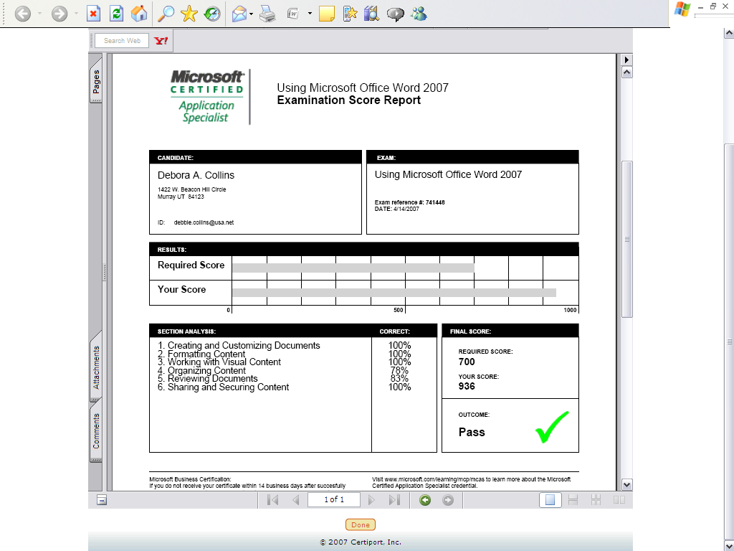
Sample Exam Score Report
The score report shows you the required passing score, your score and percentage performance in each topic area.
Like all Microsoft exams, a perfect score is 1000.
Notes:
Sample Script:
Explain the anatomy of an MCAS exam “score report” as follows:
Instruct the participants where to pick up their exam results.
Explain the Candidate information box and the Exam identification box.
Explain the bars depicting the Required Score vs. Your Score.
Explain the Section Analysis and Correct boxes
Explain the Final Score and Outcome boxes

Slide 29

Digital Transcript Service (free)
Secure, authenticated website
Candidates can view exam results
and certifications online at any time
Instantaneous results
Access can be granted to educators,
employers, and staffing agencies to
verify candidate results
Notes:
Sample Script:
Explain that after passing an exam their MCAS certificate may not arrive in the mail for up to 2 weeks; however, their profile on the Certiport website will record their exam results immediately in their “electronic transcript”. Explain the items on the slide.

Slide 30
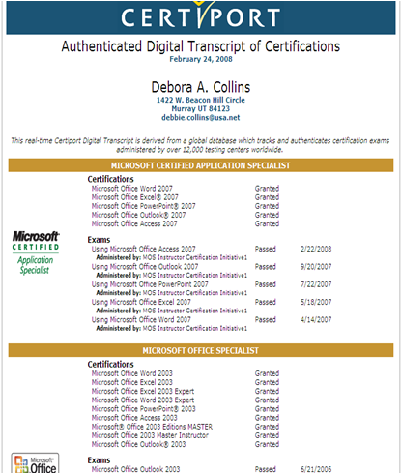
Sample Digital Transcript
The transcript available on the Certiport website keeps a history of all Office exams passed (back to Office 97).
It also displays the date each certification was awarded.
The transcript does not show your score or how many attempts were made before passing an exam!
Access to your digital transcript may be granted to third-parties.
Notes:
Sample Script:
Explain that the “digital transcript” only reports when the exam was passed, not how many times it was attempted or the score achieved. Also emphasize the importance of remembering your Certiport login name and password so that a career history of all exams and certifications can be kept in one profile.
30

Slide 31
To Implement An MBC Program
Become an Authorized Test Center
    - apply at http://www.certiport.com
Acquire Microsoft Office software
    - contact Microsoft about IT Academy Program
Acquire a good textbook
Obtain a site license for Certiprep practice test software and certification exams
Identify a “certifiable” teacher (pass the exam)
Notes:
Sample Script:
Briefly explain how easy it is to implement an MBC certification program in a school.

Slide 32
Microsoft® Office Certifications
To learn more about MBC certifications:
http://www.microsoft.com/learning/msbc
Menu Tabs:
1. Overview
2. MCAS and MOS Certifications
3. Master Certification
4. FAQ
Notes:
Sample Script:
Encourage participants to visit the Microsoft website for more information on Office certification.

Slide 33
Notes:
Sample Script:
Introduce the Adobe Certified Associate program.

Slide 34
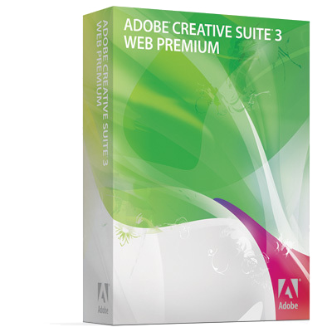
“Tools” of the Young Digital Worker
Most common tools for web, graphics, audio, video and animation.
  Dreamweaver
  Flash
  Photoshop
Notes:
Sample Script:
Explain the content on the slide.

Slide 35
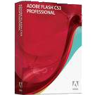
Fact #1: The Internet Uses Adobe
Flash content reaches over 98% of Internet viewers. Adobe® Flash Player is the world’s most pervasive software platform, used by over 2 million professionals.
Source: Millward Brown survey, conducted December 2007.
Notes:
Sample Script:
Emphasize the pervasiveness of Flash on the Internet.

Slide 36
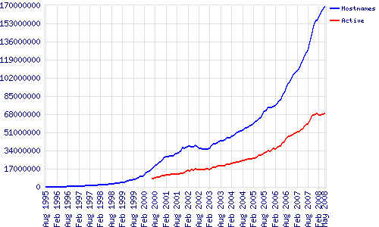
Fact #2: The Internet is Growing
In 2007, the Web gained a record 45 million sites in one year, making the total over 150 million sites on the Internet.
Source: http://news.netcraft.com/archives/web_server_survey.html
Notes:
Sample Script:
Emphasize the rapid growth of the Internet.

Slide 37
Fact #3: Need Video, Audio & Web
Since 2000, demands for specialized digital tasks have increased. Nearly 20 percent of the respondents surveyed said they performed video, audio, Web, or graphic production tasks once or twice a week while approximately another 40 percent stated they executed such tasks at least once every couple of months.
Source: “Digital Media Skills Initial Findings,” California Community Colleges Media & Entertainment Initiative (MEI), January 2006.
Notes:
Sample Script:
Emphasize the “new” digital skills required by employers are video, audio, web and animation production.

Slide 38
Fact #4: Digital Tasks Growing
Over the past five years, the average growth of users in what was considered specialized digital tasks is greater than more mainstream tasks. Specifically, animation, video, and audio are the fastest growing areas with more than 35% growth over the last five years.
Source: “Digital Media Skills Initial Findings,” California Community Colleges Media & Entertainment Initiative (MEI), January 2006.
Notes:
Sample Script:
Emphasize the demand for skills to develop video, audio, web and animation have increased by 35% over the past 5 years.

Slide 39

Fact #5:Young People are Creating
Young people are creating in Dreamweaver and Flash for effective and immediate communications on the web and on mobile devices.
.
Source: http://news.netcraft.com/archives/web_server_survey.html
Notes:
Sample Script:
Emphasize that “young people” are the ones embracing and acquiring these new digital skills.

Slide 40
Adobe Certified Associate
May, 2007 – The 1st entry-level Adobe certifications were released
The Adobe Certified Associate validates that students have essential digital communication skills to succeed in 21st-century careers
Notes:
Sample Script:
Introduce the three Adobe Certified Associate certifications.

Slide 41
The ACA Programs
  Digital Literacy Skills Certified
    Use of Photoshop, Dreamweaver and Flash
    Exams available in either CS3 or CS4 versions
  Appropriate Candidates for Certification
    Academic
    Middle School Students
    High School Students
    Post-Secondary Students
Notes:
Sample Script:
Explain the diverse target audience of this program.

Slide 42
Choice of Adobe 3 Exams
  Web Communication Using Dreamweaver
    Basic knowledge of designing and maintaining
    websites (multiple-choice plus simulations)
  Visual Communications Using Photoshop
    Basic knowledge of editing images for web, print and
    video (multiple-choice plus simulations)
  Rich Media Communications Using Flash
    Basic knowledge of creating animations for websites
    (multiple-choice plus simulation)
Notes:
42
Key points:
Briefly explain the three areas of certification available.

Slide 43
General Exam Objectives
Web Communication Using Dreamweaver | Rich Media Communication Using Flash | Visual Communication Using Photoshop
Set project requirements Plan site design & page layout Understand the Adobe Dreamweaver interface Adding content Organize and modify content Evaluate and maintain a site | Set project requirements Identify rich media design elements Understand the Adobe Flash Interface Build rich media elements Evaluate rich media elements | Set project requirements Identify design elements when preparing images Understand the Adobe Photoshop Interface Manipulate images Evaluate digital images
FREE - Study Packets Available for both CS3 and CS4
Objectives for the exam
Practice materials with image assets
Sample exam items
To download visit, http://www.certiport.com
Notes:
43
Key points:
Briefly explain the content tested by the three exams.

Slide 44




Adobe Teaching Resources - FREE
Visual Design: Foundations of Design and Print Production
A yearlong, project-based curriculum that develops communication career skills in print production and graphic design.
Digital Design: Foundations of Web Design
A yearlong, project-based curriculum that develops communication career skills in website design and production.
Digital Video: Foundations of Video Design and Production
A yearlong, project-based curriculum that develops communication career skills in digital video production.
http://www.adobe.com/education/instruction/teach/digitalcareers.html
Notes:
Sample Script:
Introduce that Adobe has created three year-long curricula that prepares students for the three associated exams.

Slide 45
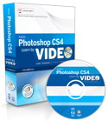
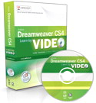
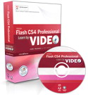
Adobe Learning Resources - $54
Learn Adobe Photoshop CS4 by Video: Core Training on Visual Communication Combines 19 hours of interactive video and a printed reference to teach you the basics of Photoshop CS4.
Learn Adobe Dreamweaver CS4 by Video: Core Training on Web Communication Combines 14 hours of interactive video and a printed reference to teach you the basics of Dreamweaver CS4.
Learn Adobe Flash CS4 by Video: Core Training on Rich Media Communication Combines 15 hours of interactive video and a printed reference to teach you the basics of Flash CS4 Professional.
http://www.adobe.com/education/instruction/ace/
Notes:
Sample Script:
Introduce that Adobe has created three video-based tutorials that prepares individuals for the three associated exams.

Slide 46
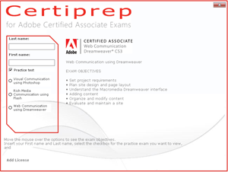
Certiprep for Adobe by Certiport
Similar to the REAL exam!
One mode: Practice Test
Does not require an installation of
Adobe!
For pricing, contact Carolina Cayaffa
Email: ccayaffa@certiport.com
Notes:
Sample Script:
Explain that a Certiprep is now available for Adobe!

Slide 47
Adobe Classroom License
$ 40,000 value!
Unlimited ACA exams in 1 classroom up to 30 computers (all exam versions included)
Certiprep Practice Tests
Adobe curriculum on DVD (ISTE aligned)
Per classroom 1 yr. subscription only $2,500!!
Does NOT include Adobe software!
For more info, contact ccayaffa@certiport.com
Notes:
Sample Script:
Explain the bullet points on the slide.

Slide 48
Adobe® Exam Characteristics
This is what to expect -
Mix of multiple-choice and simulations
50 minute length
39-41 test items
Score required to pass varies with exam
(DW 58%; Photoshop 60%; Flash 70%)
Skills measured are posted on Adobe
website (the objectives previously discussed)
Notes:
Sample Script:
Briefly discuss the general characteristics of an Adobe exam.

Slide 49
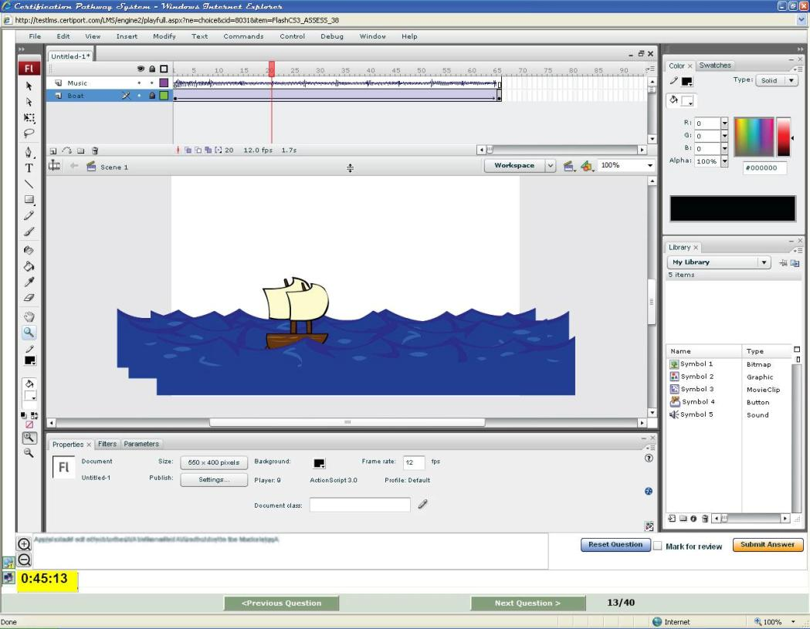
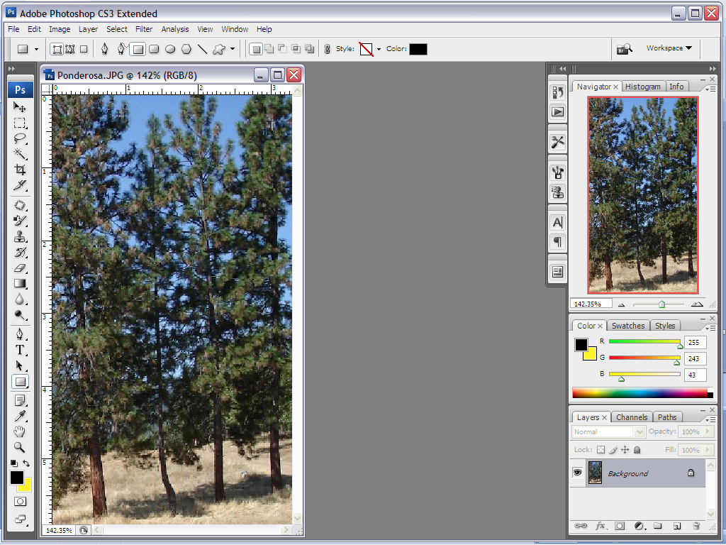
Sample Adobe Exam Items
Notes:
Sample Script:
Explain the exams are composed of a mix of multiple-choice and simulated items.
49

Slide 50
To Implement An ACA Program
Become an Authorized Test Center
    - apply at http://www.certiport.com
Acquire Adobe software
    - contact Adobe for academic licenses
Acquire a good textbook
Obtain a site license for Certiprep practice test software and certification exams
Identify a “certifiable” teacher (pass the exam)
Notes:
Sample Script:
Briefly explain how easy it is to implement an Adobe certification program in a school.

Slide 51
ACA Certifications
To learn more about ACA certification:
http://www.adobe.com/education/instruction/ace/
Notes:
Sample Script:
Encourage participants to visit the Adobe website.

Slide 52
OnSite Workshops
Need help getting started? We’ll come to your site and show you how it’s done! Send us an email and let’s talk!!
Train-the-Teacher Workshops
(I’ll certify your teachers and show them how to certify students!!)
Available for Microsoft and Adobe
Notes:
Sample Script:
Mention that Debbie is available to come onsite and certify teachers on either Microsoft or Adobe.

Slide 53

Our Workshop Model
Since 2005, our model has consistently resulted in certification pass rates of 86% to 92%!
Notes:
Sample Script:
Explain that Debbie will now introduce “The Model” that we’ve been successfully delivering for the past 4 years!

Slide 54
Workshop Timeline
3-4 Weeks Prior…
1 Week Prior…
During Workshop
Screen Participants
Reminder Email
Workshop Agenda
MCAS Overview
Objectives Demos/Follow
Practice Lab (optional)
Enroll Participants
Setup Classroom
Certification Exam
Pre-Workshop Assignments
Download prep software
Complete assigned modules
Email results to trainer (>85%)
Notes:
Sample Script:
Discuss the importance of the timeline.

Slide 55
Workshop Formats
1-Day Workshop
Prepare and Pass 1 Exam
OR
2-Day Workshop
First Day = Prepare and Pass 1st Exam (i.e. Word)
2-Day Workshop
Second Day = Prepare and Pass 2nd snd possibly 3rd Exam
For multiple exam workshops, I recommend the following:
2 exams - Minimum 2 weeks “self-study” + 2 days workshop;
3 exams - Minimum 3 weeks “self-study” + 2-3 days workshop;
4 exams (MCAS Master) – 3-4 weeks “self-study” + 3 days workshop
Schedule allows for one exam retake, if needed.
Notes:
Sample Script:
Discuss the variations of this format for 1, 2, 3 or 4 exams.

Slide 56
Notes:
Sample Script:
Introduce IC³

Slide 57
IC³ Program
  Digital Literacy Certified in 3 Areas
    Computing Fundamentals, Key Applications, Living Online
  Appropriate Candidates for Certification
    Academic
    Junior High School
    High School Students
    Post-Secondary Students
    Workers
    Workforce Services Clients
    Employees of Corporations
Notes:
Sample Script:
Explain the diverse target audience of this program. Also, nention the ISTE Seal of Alignment and endorsement of the IC³ program.

Slide 58
IC³ Consists of 3 Exams
  Computing Fundamentals Exam
    Basic knowledge of computer hardware, software and operating systems
  Key Applications Exam
    Use of word processing, spreadsheet and presentation software
  Living Online Exam
    Basic knowledge of computer networking, email, safe use of the Internet, and the impact of computers on society
Notes:
58
Key points:
Introduce the three exams.

Slide 59
IC³ Exam Characteristics
This is what to expect -
Mix of multiple-choice, simulations and matching questions
45 minute length
45 test items with one or more tasks
Score required to pass varies with exam
(most IT exams range from 65-80%)
Source: US Dept. of Education, October 2000
Skills measured are posted on Certiport’
website (the objectives previously discussed)
Notes:
Sample Script:
Briefly discuss the general characteristics of an MCAS exam.
Point out that the score required to pass a Microsoft Office exam is typical of other exams in the IT industry.
A study released by the US Dept. of Education in a publication titled, A Parallel Postsecondary Universe: The Certification System in Information Technology - October 2000 reveal that “cut-scores” for certification exams in the IT industry typically range between 65-80%.
As stated in the Microsoft Office 2003 Step by Step books:
“Passing standards (the minimum required score) for Microsoft Office
Specialist certification exams range from 60 to 85 percent correct,
depending on the exam.”
4. Explain that “cut-scores” can change as IT exams are updated during their lifecycle.
5. Explain that the 85%+ score participants are required to achieve when preparing for a workshop is to help them master the skills needed to more easily achieve the “cut-score” required on the actual certification exams.

Slide 60
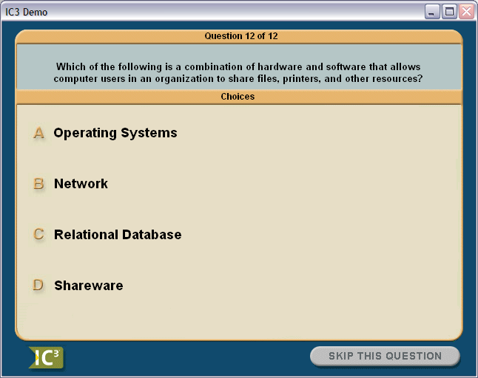
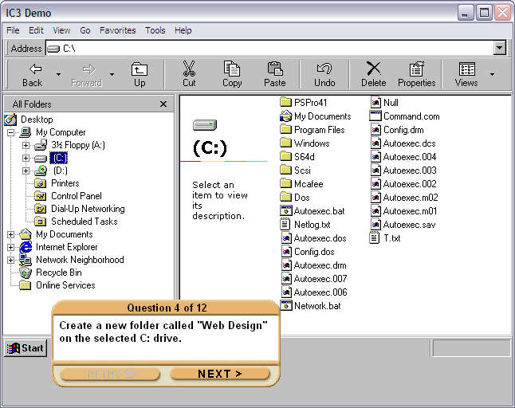
Sample IC³ Exam Items
IC³ Certification Pathway
Notes:
Sample Script:
Explain the exams are composed of a mix of multiple-choice and simulated items.

Slide 61
Introducing
IC³ Global Standard 3
Notes:
Introduce the new IC3 standard.

Slide 62

IC³ Global Standard 3 (GS3)
R&D began in 2008 to update the IC³ standards
Over 400 SMEs from 30+ countries participated
in an IC³ standard update survey.
Global Digital Literacy Council (GDLC)
ratified IC³ GS3 in August 2008.
  - Council has 19 members representing 9 countries
IC³ GS3 beta began in March 2009
IC³ GS3 exams (English) released June 2, 2009
Notes:
Explain the bullets

Slide 63
What You Can Expect
Format of exams remains the same
  - Must pass Computing Fundamentals, Key Applications and Living Online to achieve IC³ certification
Mixing and matching of exams allowed!
  - IC³ 2005 CF + IC³ 2007 KA + IC³ GS3 LO = CERTIFICATE
Cut scores.
  - Tougher exams have lower cut scores (660 to 710)
50% linear and 50% performance based questions.
Includes Office 2007, IE 7.0 and Windows Vista.
Updated with current technologies like blogging, wikis, social networking, chat/messaging, etc.
Exams now delivered on LMS.
Notes:
Explain the bullets

Slide 64
Benefits
All existing IC³ inventory (electronic and vouchers) can access the IC³ GS3 exams
Updated IC³ certificate
New IC³ GS3 Authorized Instructor Program
Official launch occurred at NECC, June 2009
Notes:
Explain the bullets

Slide 65
Coming Soon (4th Qtr. 2009)
IC³ GS3 exams in other languages
(including Spanish)
IC³ GS3 Practice Tests in English.
IC³ GS3 Approved Courseware.
Notes:
Explain the bullets

Slide 66

IC³ Certification
To learn more about IC³ certification:
http://www.certiport.com/ic3
Notes:
Sample Script:
Encourage participants to visit the Certiport booth and website.

Slide 67
Arkansas Sales Contact
Notes:
Sample Script:
Thank everyone for attending and answer questions.

Slide 68
Please submit your evaluation as you exit to receive a FREE gift!
- includes this slide presentation and other information on the products you’ve seen today!!
Notes:
Sample Script:
Remind participants to submit their evals before leaving.

Slide 69
Questions?
Thank You for Attending:
“MCAS and Adobe
Certifications”
Notes:
Sample Script:
Thank everyone for attending and answer questions.

